Slide 1

VALENTINE'S DAY GIFT RECOMMENDATION USING MACHINE LEARNING
TEAM 9

Slide 2
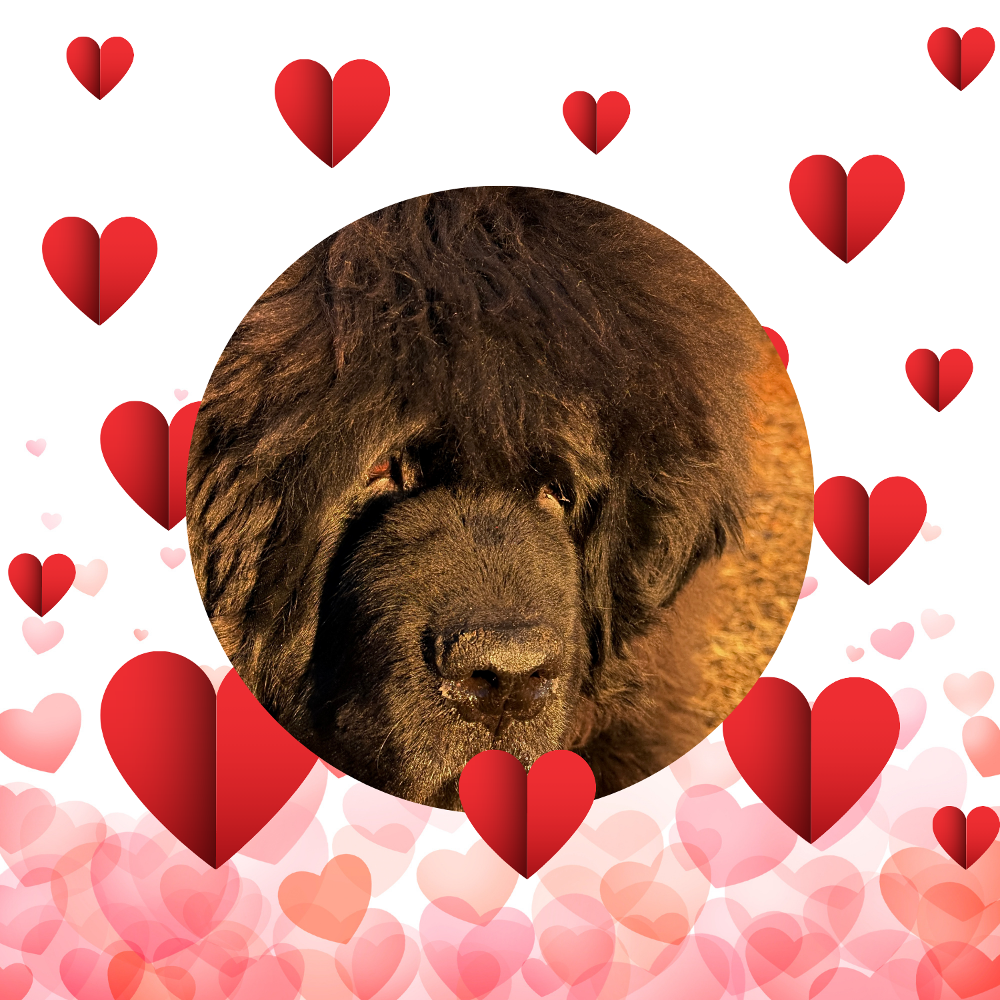
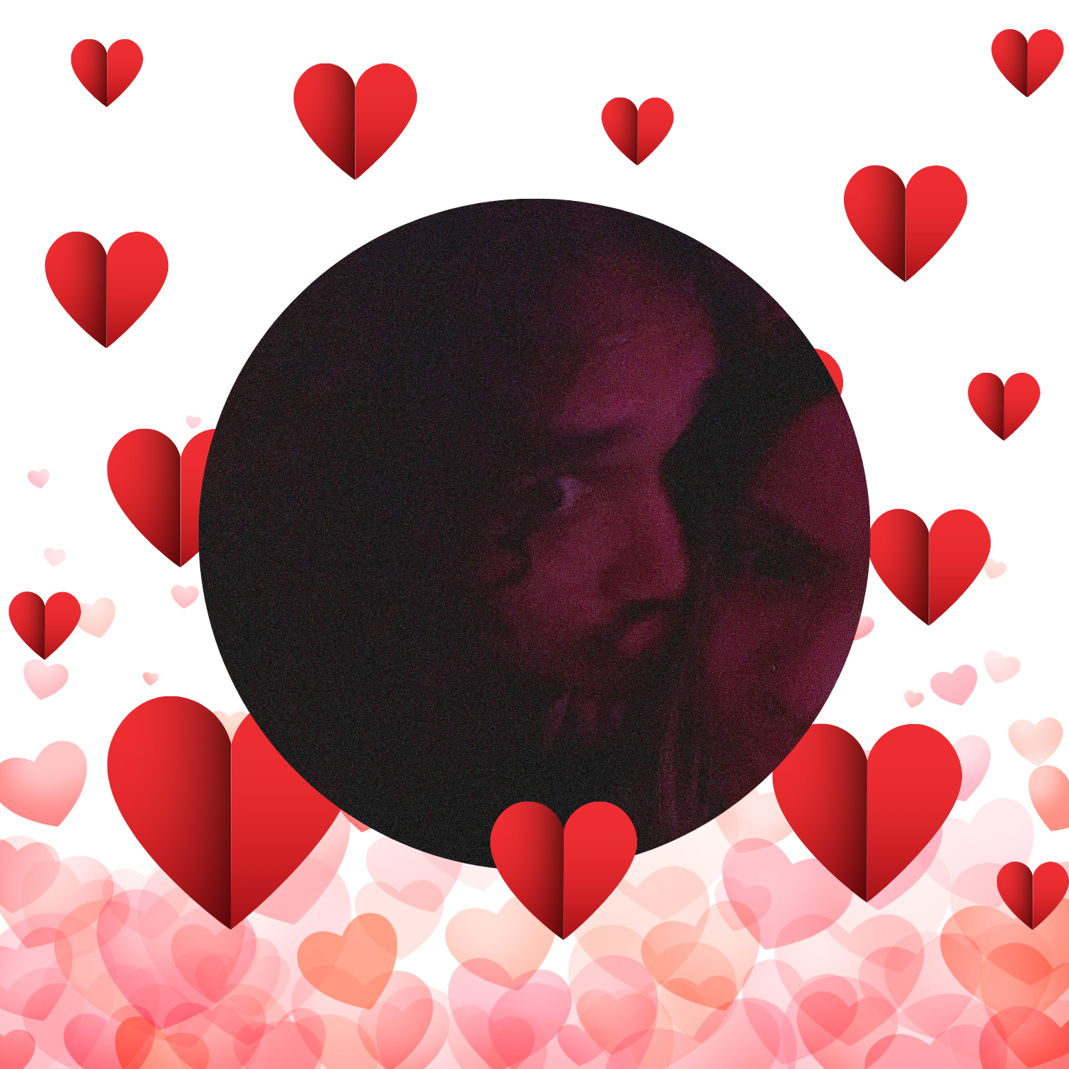
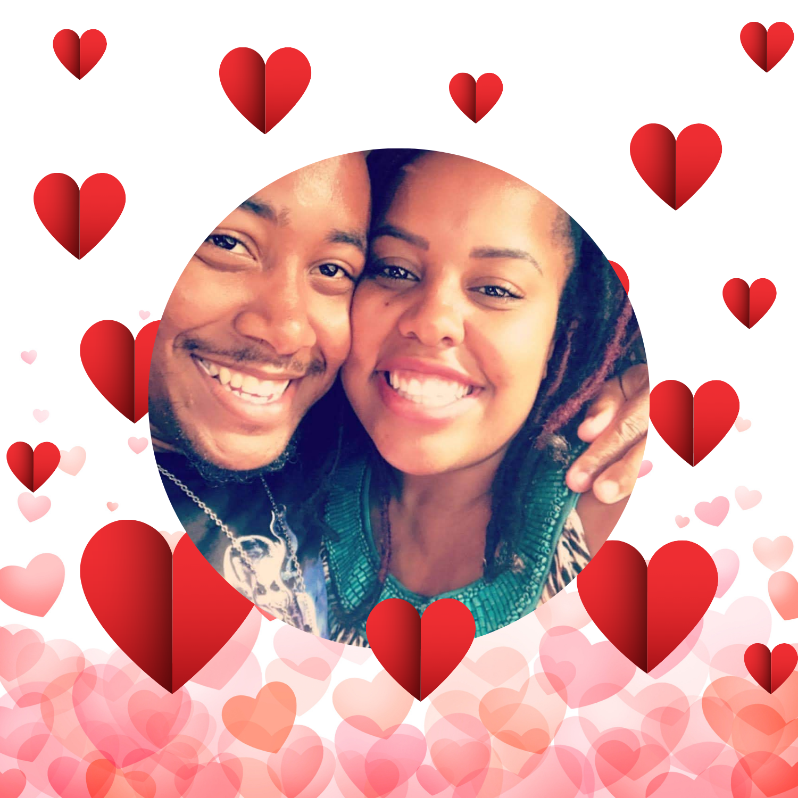
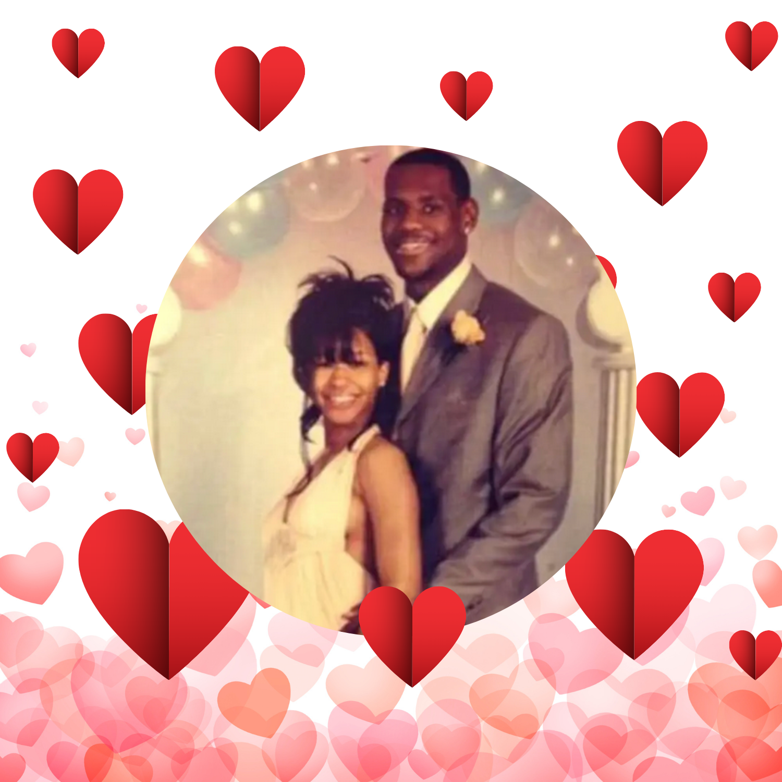
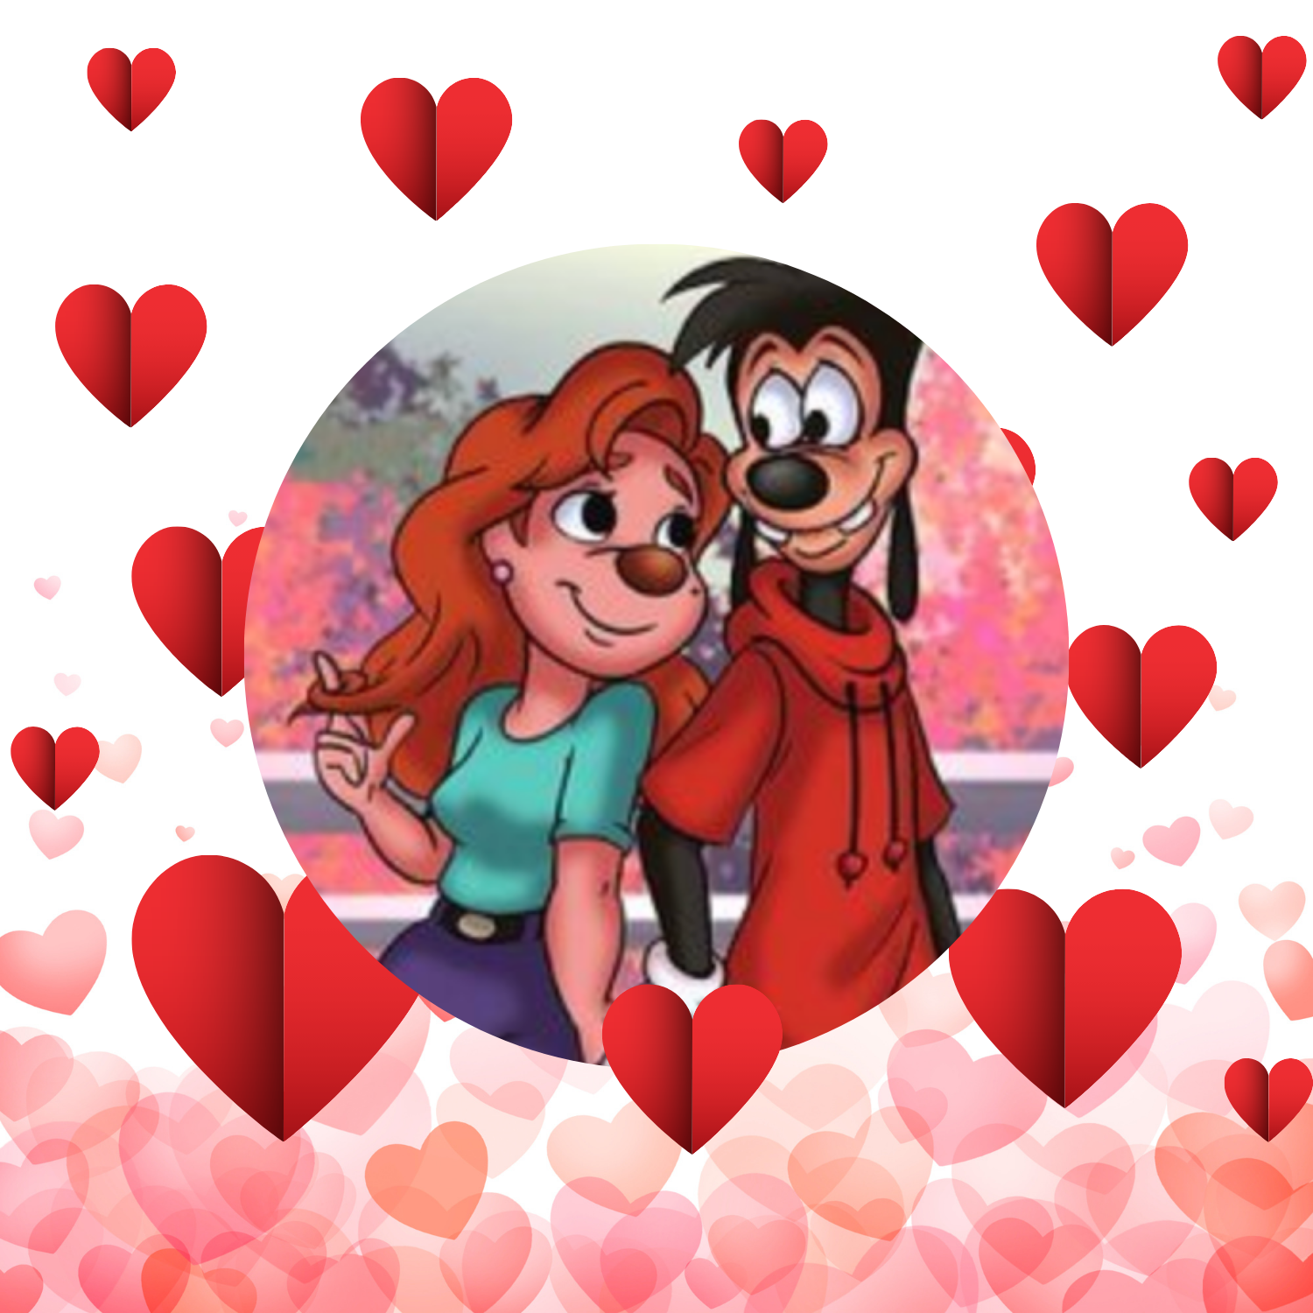
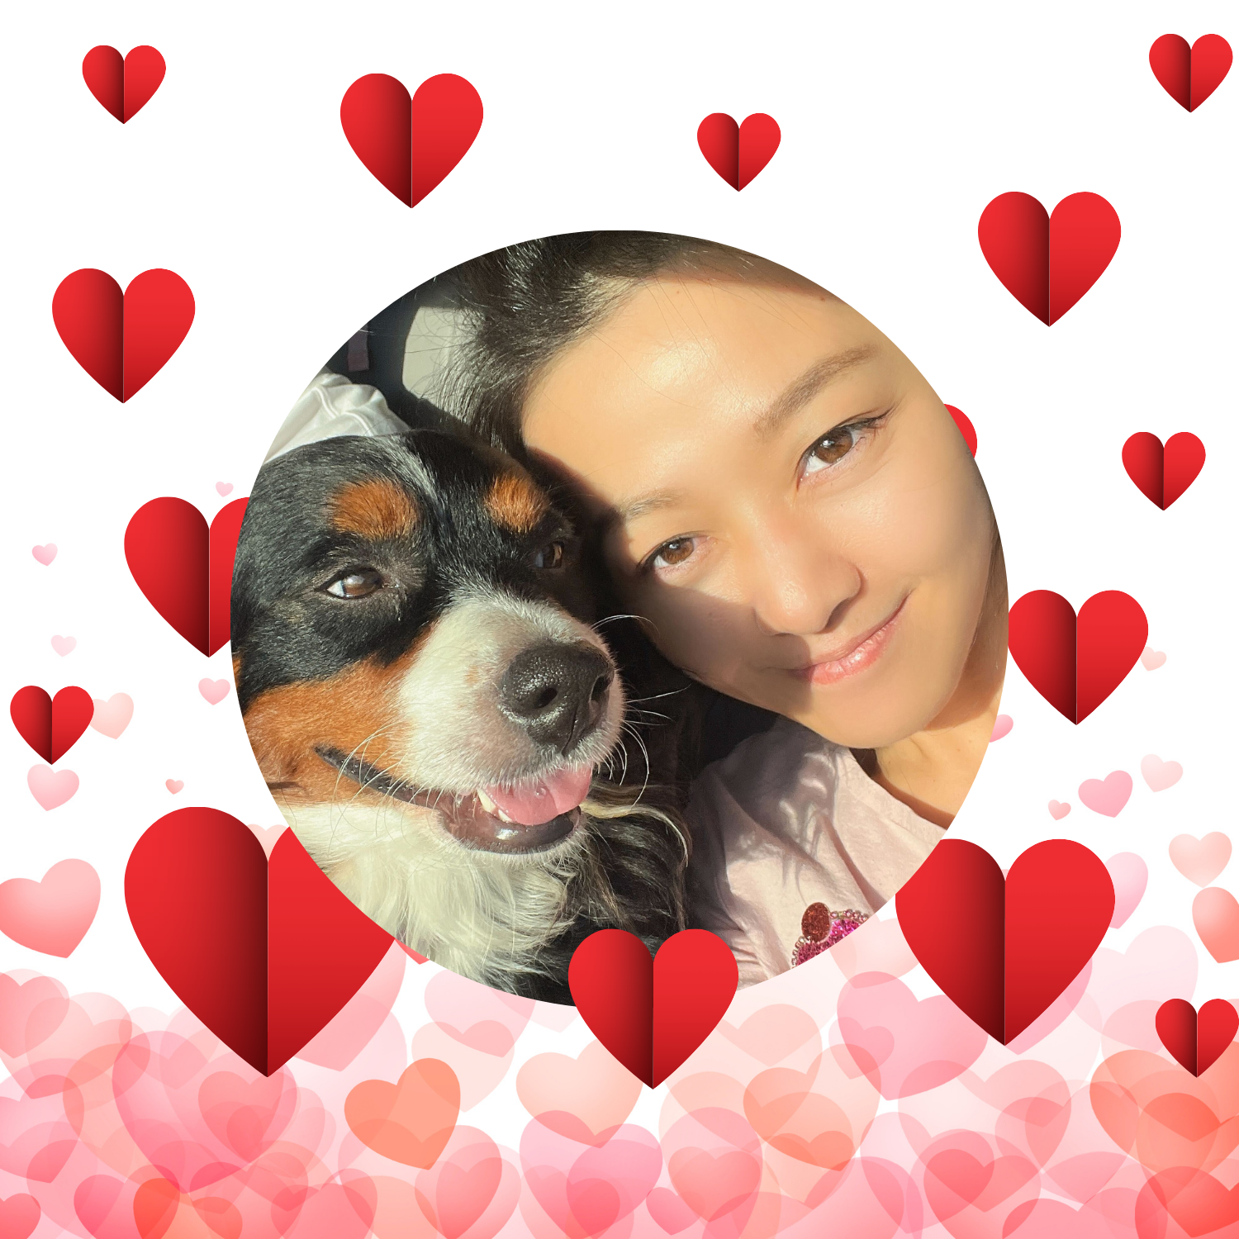
CONTRIBUTORS
Gabriel Galley
Leonard Forrester
Leslie Bland
Rakesh
Sophak So
Yujing Li

Slide 3
EXECUTIVE SUMMARY & PROJECT GOALS
Objective:
Develop a machine learning model that helps users select the best Valentine's Day gift based on recipient characteristics.
Approach:
Created a synthetic dataset (using ChatGPT) to simulate gift preferences when no public dataset was available.
Experimented with classification models (e.g., Decision Trees and Random Forests) using Scikit-learn.
Long-Term Vision:
Enhance the gift-giving experience through data-driven insights.
Lay the groundwork for future improvements (dataset refinement, advanced modeling, user-friendly interface).

Slide 4
DATA COLLECTION & CLEANUP
Data Collection:
Generated a synthetic dataset containing 2000 records with features like recipient type, relationship length, budget, personal preferences, etc.
Prompt engineering helped iterate on improvements to dataset until successfully correlated data emerged.
Data Cleanup & Preprocessing:
Cleaned and formatted the dataset.
Handled missing values, removed redundant or low-impact categories, and encoded categorical variables for model compatibility.

Slide 5
Data Pre-Processing
Dropping Unnecessary Columns
identify and remove irrelevant columns
df.drop()
Feature Scaling
Normalize or standardize features to improve model performance
StandardScaler
Encoding Categorical Data
Convert categorical variables into numerical form
Hot Encoding & Label Encoding
Splitting Dataset
Separate feature(X) and target variable (y)
train_test_split()

Slide 6
MODEL TRAINING, TESTING & EVALUATION
Model Development:
Implemented classification algorithms: Decision Trees, Random Forests, Support Vector, & AdaBoost .
Experimented with tuning and feature selection based on insights from the exploratory analysis.
Evaluation Process:
Split data into training and testing sets to assess model performance.
Evaluated models using metrics like accuracy & adjusted R-squared.
The Decision Tree model was selected as the best fit based on the eval.
Noted improvements: initial accuracy around .17%, later iterations achieving over .95% following data refinement.
Insights:
Certain features (e.g., Relationship Status and Personal Interest) were more influential than others.
Notes:
*Training- Trains multiple classification models to identify the best models. Used pipeline; scaling and splitting the data into training and testing sets.
*Testing- models are tested on the x-test. Predictions are generated using “predict” comparing it to the actual target value
*Evaluation- Model performance; using accuracy score and adjusted R-suqared. Decision tree yielded best results

Slide 7
PROJECT APPROACH & METHODOLOGY
Iterative Process:
Begin with dataset generation and cleaning, followed by exploratory analysis.
Cycle through model development and testing, using correlation insights to refine features.
Technical Stack:
Programming Language: Python
Libraries: Pandas, NumPy, Scikit-learn, Matplotlib, Seaborn
Environment: Google Colab
Key Decisions:
Use of synthetic data due to lack of public datasets.
Focus on classification techniques to address the personalization challenge.

Slide 8
RESULTS & CONCLUSIONS
Findings:
The synthetic dataset provided a good starting point, but the story it can tell is limited to the logic that built it.
Classification models themselves demonstrated success, with improvements observed through iterative refinements.
Conclusion:
Machine learning can feasibly personalize gift recommendations.
The project provides a solid foundation for future enhancements in data quality, model sophistication, and application usability.

Slide 9

Demo
Demo Link:
https://vimeo.com/1058422509/26c8057dd0
Notes:
Leslie’s slide

Slide 10
FUTURE DIRECTIONS & RESEARCH OPPORTUNITIES
Dataset Refinement:
Collect real-world data to improve prediction accuracy.
Advanced Modeling:
Explore deep learning methods (e.g., neural networks) for enhanced performance.
Feature Engineering:
Incorporate additional features that might affect gift preferences.
User Interface Development:
Build a user-friendly application for real-time gift recommendations.
Collaboration:
Partner with gift retailers or survey platforms for richer datasets and insights.
Notes:
Leslie’s slide

Slide 11


APPENDIX: SUPPLEMENTARY INFORMATION
VALENTINE'S DAY GIFT RECOMMENDATION USING MACHINE LEARNING Repo:
https://github.com/roddarakesh/proj_2/tree/main
.
Notes:
Leslie’s slide

